Slide 1

KONGUNADU COLLEGE OF ENGINEERING AND TECHNOLOGY
(AUTONOMOUS)
Tholurpatti (P.O), Thottiam –T.K, Trichy – 621 215.
(Approved by AICTE, New Delhi & Affiliated to Anna University, Chennai, Accredited by NBA (CSE, ECE & EEE), Accredited by NACC with B++ Grade, Recognized by UGC with 2 (f) & 12(B) and ISO 9001:2015 certified Institution)
DEPARTMENT OF ELECTRONICS AND COMMUNICATION ENGINEERING
20EC506L – Mini PROJECT – I
FIRST review
REAL TIME IMAGE BASED SMART VOTING SYSTEM
ACADEMIC YEAR: 2023-2024 BATCH NO: 19 YEAR/SEMESTER: III/V
GUIDEDED BY Dr. B. UMARANI ME.,(Ph.D), Prof ECE,
KNCET.
Presented by
SIVAMURUGAN G (621321106098)
TAMILSELVAN S (621321106109)
VETRIVEL K (621321106115)

Slide 2
INTRODUCTION
In an era characterized by technological advancements , traditional voting methods are being reimagined to ensure greater accessibility , transparency in the democratic process.
A real-time image based smart voting system is a voting system that uses image processing and facial recognition technology to identify and authenticate voters in real time.
This type of system can be used to improve the security and efficiency of elections, as it can help to prevent voter cheat and impersonation.

Slide 3
Contd.,
The voter arrives at the polling station and presents their identification document to an election official.
The election official scans the document and the voter's image is captured by the camera . The facial recognition software compares the voter's image to the images in the database.
If the voter is identified as a registered voter, they are allowed to cast their vote .
The voter casts their vote by entering their PIN or fingerprint on the voting terminal . The vote is then recorded in the database.

Slide 4
ABSTRACT
The purpose of creating a Real-Time Image Based Smart Voting system is to improve the democratic voting process in several ways like efficiency , accuracy and reduce the cheating in vote.
By providing biometric verification , efficient registration , and real time image analysis , this system streamlines the voting experience.
It accommodates individuals with disabilities , ensures data security through encryption and block chain and offers real time election results.
This system holds the promise of making elections more accurate , accessible , and trustworthy , reshaping the future of democracy.

Slide 5
OBJECTIVES
The objectives of a real-time-image-based smart voting system are multi-faceted and designed to enhance the democratic process.
Implement robust security measures , including biometric verification and encryption , to prevent fraud and maintain the integrity of the voting process.
This project is deliver election results in real time to enhance public confidence and expedite the announcement of winners.

Slide 6
SCOPE OF THE PROJECT
The scope of a real-time image-based smart voting system encompasses various aspects and functionalities within the context of modernizing and enhancing the electoral process.
Voter Registration and Verification : Online pre-registration for eligible voters. Biometric verification using facial recognition and fingerprint scanning.
Compliance and Legal Framework : Adherence to election laws, regulations, and standards . Collaboration with relevant government authorities and election commissions.
Public Awareness and Education : Initiatives to inform and educate voters about the new voting system.

Slide 7
PROBLEM IDENTIFICATION
Conventional voting methods often lead to long queues and extended waiting times at polling stations, discouraging voter turnout.
Manual vote counting can introduce human errors, potentially affecting the accuracy of election results.
Instances of voter fraud, such as impersonation or multiple voting, can undermine the integrity of elections.
Traditional vote counting and result reporting processes can lead to delayed election results, causing uncertainty and tension.
The COVID-19 pandemic highlighted the need for alternative voting methods to ensure public health and safety.

Slide 8
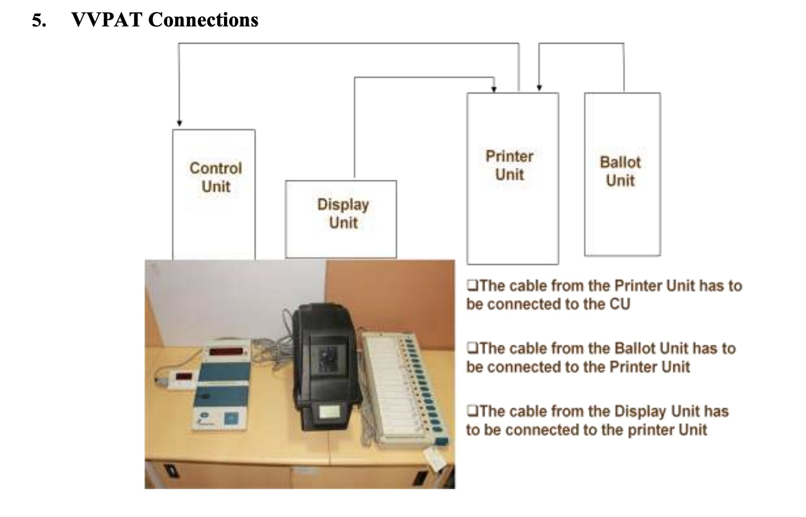
EXSISTING SYSTEM BLOCK DIAGRAM

Slide 9
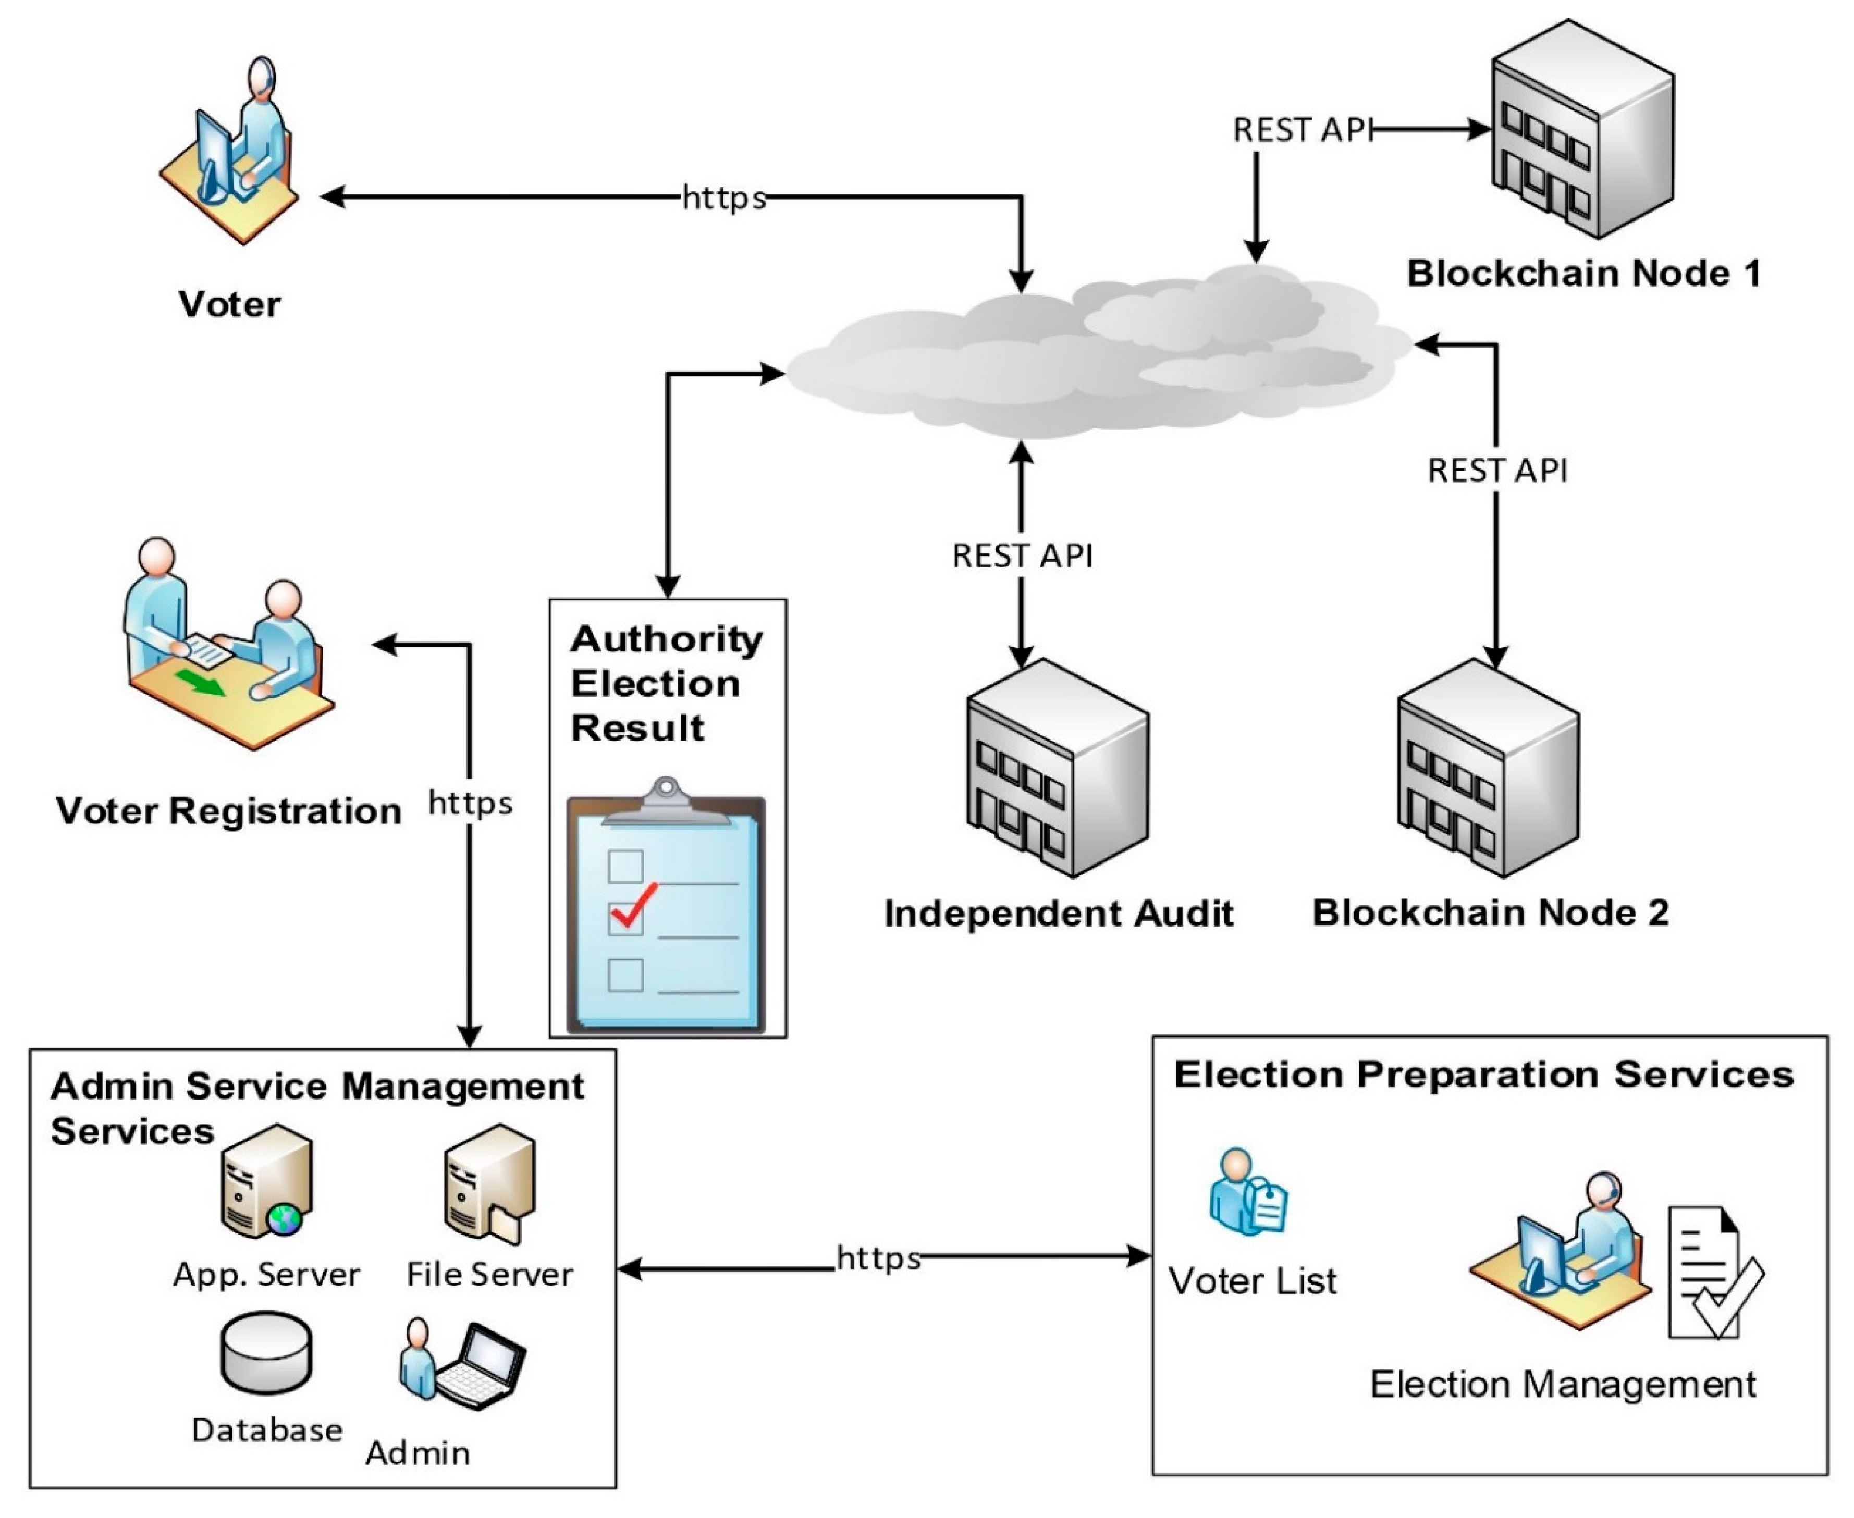
PROPOSED BLOCK DIAGRAM

Slide 10
SOFTWARE REQUIREMENTS
Python language
HARDWARE REQUIREMENTS
Webcam
Computer
Storage device
Network connection
10

Slide 11
REFERENCES
Geetha, V. R., & Lakshmi, P. (2019). Facial recognition- based voting system. International Journal of Engineering and Advanced Technology, 9(2), 562-568.
Tokhi, M. O., Ghaderi, J., & El-Tarhuni, M. E. (2019). A face recognition-based electronic voting system using neural networks. In 2019 International Conference on Machine Learning and Data Engineering (iCMLDE) (pp. 173-177). IEEE.
Jena, J. R., & Panda, S. (2021). A secure and efficient face recognition-based electronic voting system. Journal of Ambient Intelligence and Humanized Computing, 12(1), 633-643.
Singh, R. K., Tiwari, A. K., & Kumar, A. (2021). A biometric-based secure electronic voting system using face recognition. International Journal of Computational Intelligence and Informatics, 10(1), 1- 15.

Slide 12
Contd..
5. Kumar, S., Sivasankar, M. V., & Krishnamoorthy, S. (2019). Face recognition based secured voting system using machine learning. In 2019 IEEE International Conference on System, Computation, Automation and Networking (ICSCAN) (pp. 1-6). IEEE.
6. Yurtay, E. (2020). Secure Electronic Voting System with Face Recognition. In 2020 International Congress on Human-Computer Interaction, Optimization and Robotic Applications (HORA) (pp. 1-5). IEEE.
7. Devi, P. S., & Sheeba, J. (2020). Smart and secure voting system using facial recognition and OTP. In 2020 International Conference on Inventive Research in Computing Applications (pp. 1090-1096). IEEE.
8. Feng, G., Chen, Y., & Jiang, Y. (2021). Design and Implementation of Secure E-voting System Based on Face Recognition and Blockchain. Journal of Physics: Conference Series, 1888(1), 012123.

Slide 13
THANK
YOU

